Slide 1
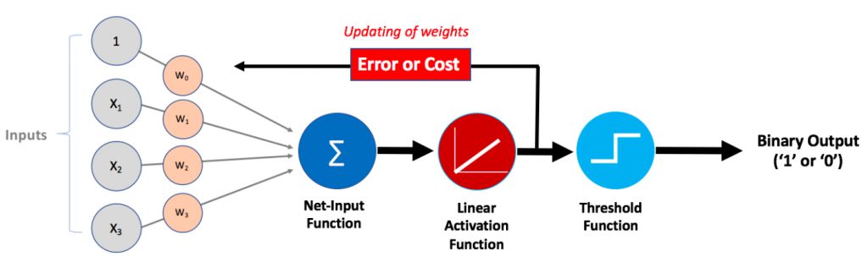
Tutorial 4
﻿CS5486 Intelligent Systems:
Adaptive Linear Neuron, Multiple Adaptive Linear Neurons, and Deep Learning Toolbox
Hongzong Li
Department of Computer Science
City University of Hong Kong

Slide 2
Adaline (Adaptive Linear Neuron)
ADALINE is a type of neural network that is based on the linear activation function. It is very similar to the perceptron but differs in its learning rule. The output of the ADALINE neuron is a linear combination of inputs, and the error is calculated using the difference between the desired output and the actual output.

Slide 3
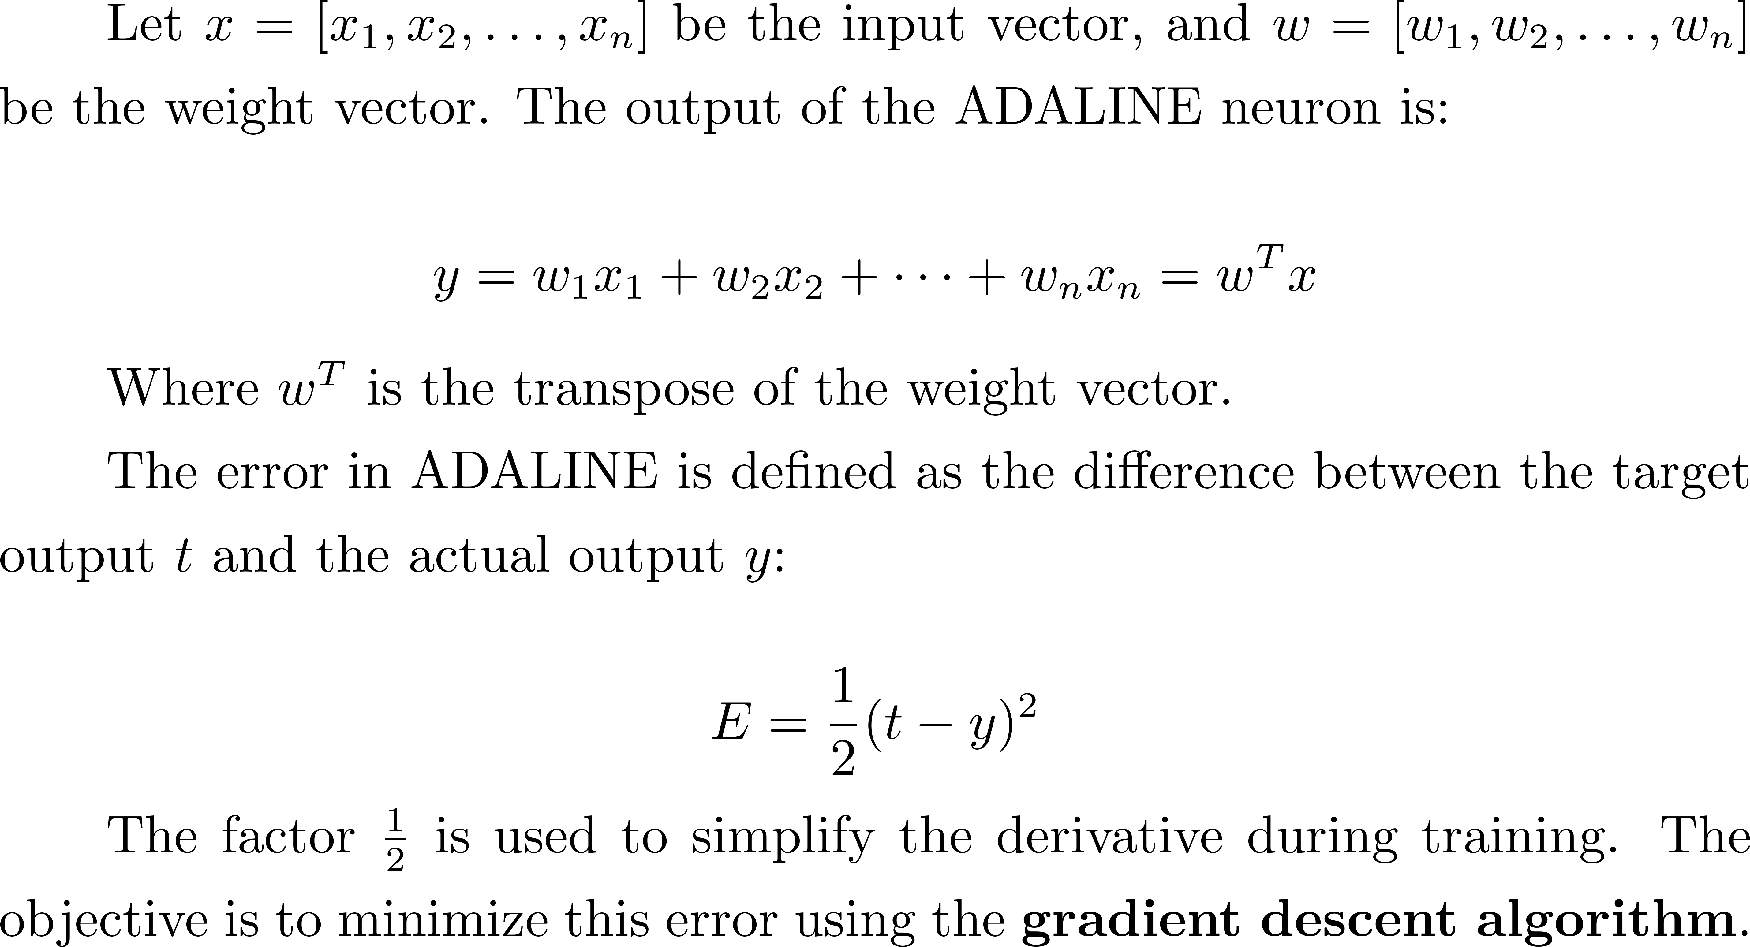
Adaline (Adaptive Linear Neuron)

Slide 4
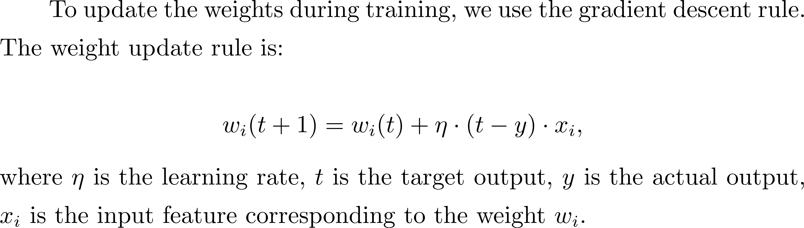
Adaline (Adaptive Linear Neuron)
Learning Rule
Steps for Training ADALINE
Repeat
Initialize weights randomly
Calculate the output
Calculate the output
Compute the error
Convergence

Slide 5
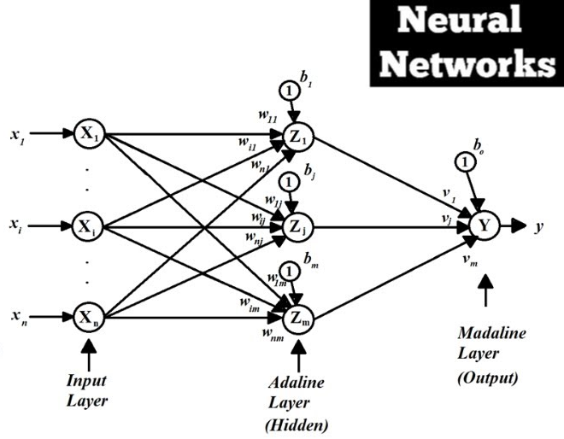
MALN (Multiple Adaptive Linear Neurons )
Multiple Adaptive Linear Neurons (MALN) extends ADALINE to multiple neurons (or units). In this case, each neuron learns a different feature or aspect of the data, and their outputs are combined in a multi-layer network.
MALN is typically used for more complex tasks where a single ADALINE would be insufficient.

Slide 6
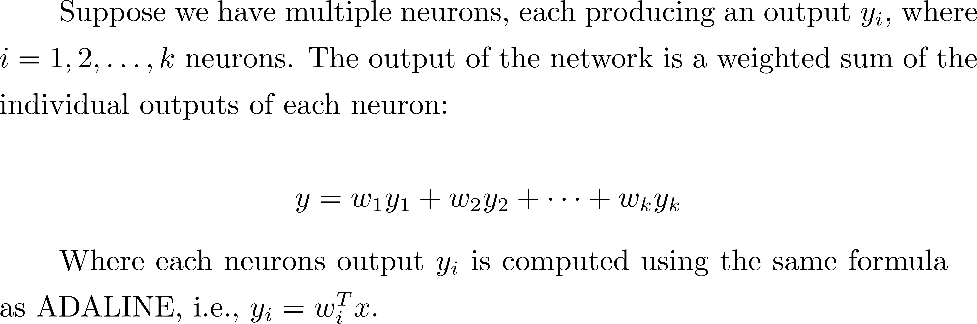
MALN (Multiple Adaptive Linear Neurons )

Slide 7
MALN (Multiple Adaptive Linear Neurons )
Learning Rule
Each neuron’s weights are updated independently according to the ADALINE learning rule. After training the individual neurons, the final weights​ are updated to combine the neuron outputs into the final prediction.

Slide 8

Deep Learning Toolbox
Deep Learning Toolbox provides functions, apps, and Simulink blocks for designing, implementing, and simulating deep neural networks. The toolbox provides a framework to create and use many types of networks, such as convolutional neural networks (CNNs) and transformers. You can visualize and interpret network predictions, verify network properties, and compress networks with quantization, projection, or pruning.
With the Deep Network Designer app, you can design, edit, and analyze networks interactively, import pretrained models, and export networks to Simulink. The toolbox lets you interoperate with other deep learning frameworks. You can import PyTorch®, TensorFlow™, and ONNX™ models for inference, transfer learning, simulation, and deployment. You can also export models to TensorFlow and ONNX.
You can automatically generate C/C++, CUDA®, and HDL code for trained networks.
Notes:
Here's an introduction of deep learning toolbox provided by the matlab website.

Slide 9

Deep Learning Toolbox
https://www.mathworks.com/help/deeplearning/index.html
Notes:
This tutorial will only show you some very basic usage. If you want to learn more in order to complete your assignments, you can visit this official page to see more usage methods and examples.

Slide 10
Function: feedforwardnet
Generate feedforward neural network
net = feedforwardnet(hiddenSizes,trainFcn)
returns a feedforward neural network with a hidden layer size of hiddenSizes and training function, specified by trainFcn.
% Specific a network with 3 hidden layers
hiddenSizes=[10,8,5]; % a vector
net = feedforwardnet(hiddenSizes,trainFcn);
Notes:
Let's look at one of the most important function.
It generates a feedforward neural network.
Its syntax is shown here.
Size of the hidden layers in the network, specified as a row vector. The length of the vector determines the number of hidden layers in the network.
Example: For example, you can specify a network with 3 hidden layers, where the first hidden layer size is 10, the second is 8, and the third is 5 as follows: [10,8,5]
net is the training function name
Feedforward neural network, returned as a network object.

Slide 11
Function: feedforwardnet
Build a 3 layer network with 10 nodes in the (single) hidden layer:
net=feedforwardnet(10);
Build a 4 layer network with 5 nodes in the first hidden layer and 3 nodes in the second hidden layer:
net=feedforwardnet([5,3]);
Notes:
This piece of code
In the remaining time, I will provide you with some examples of using the toolbox to build a neural network and train it.

Slide 12
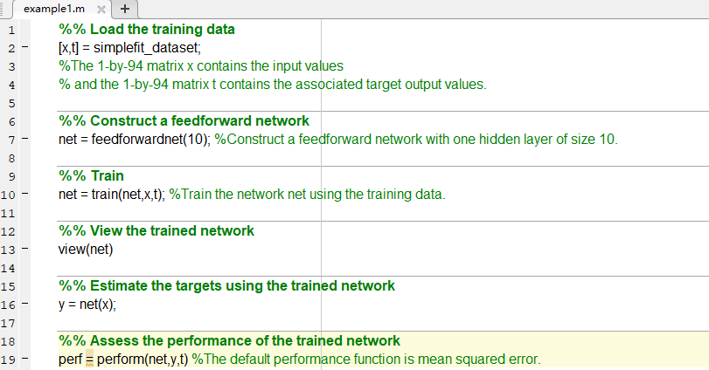
Function: feedforwardnet
Notes:
This example shows how to use a feedforward neural network to solve a simple problem.
Load the training data.
The Net object also acts as a method to make predictions and takes in the input dataset as an argument. We can also evaluate the model performance using the perform function.

Slide 13
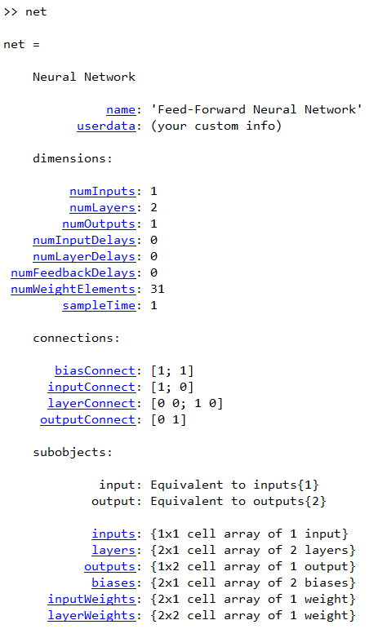
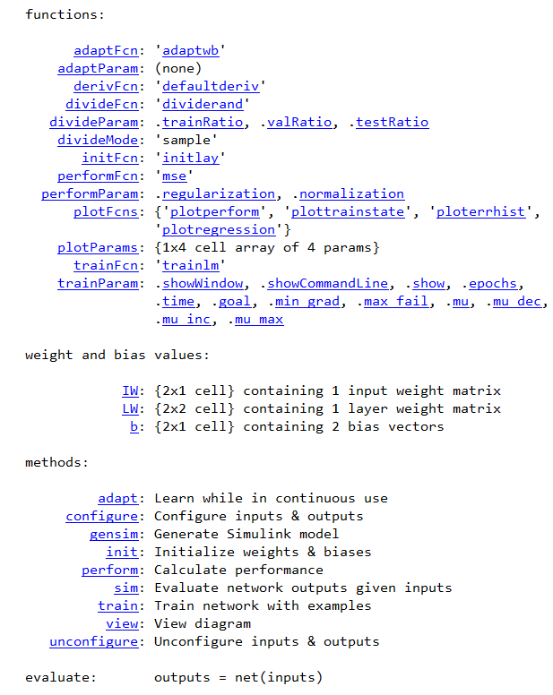
Function: feedforwardnet
Type ‘net’ in the command window
Notes:
We can start by looking at the parameters of such a network. After we create the feedforward network, type ‘net’ in the command window.
We can see the weights that can be related to net and the various parameters that can mostly be called by net. such as net.b is the call bias.

Slide 14
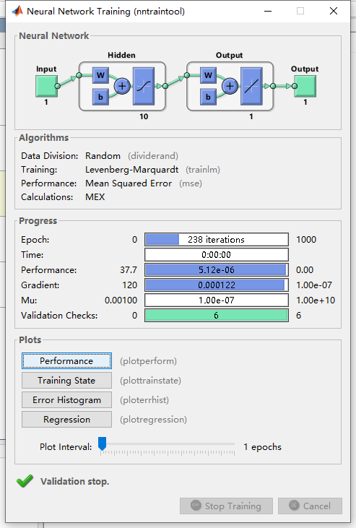
Function: feedforwardnet
Notes:
An interactive UI will also pop up during the training phase to show the model progress, which should look like the figure shown below.
Peformance: mean squared error
Another cool note about the default setting for the DLT is that it performs early stopping to avoid overfitting! So even if we specify a large number of epochs to train on, it will stop after the cost converges to a stable value.

Slide 15
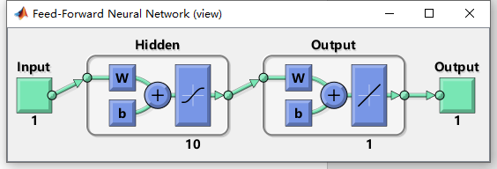
Function: feedforwardnet
A diagram of the neural network architecture using the view() function generated in MATLAB.

Slide 16
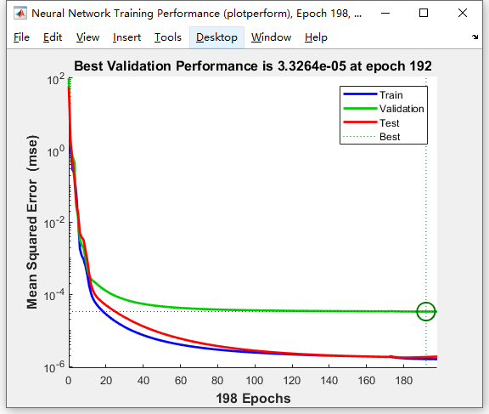
Function: feedforwardnet
Notes:
Now that we have a general sense of how the shallow neural network performed, we can visualize the results.
One diagnostic plot we can make is to visualize how the cost changes as a function of the number of epochs.
The cost computed from the training, validation, and test set seems to stabilize around 200 epochs.

Slide 17
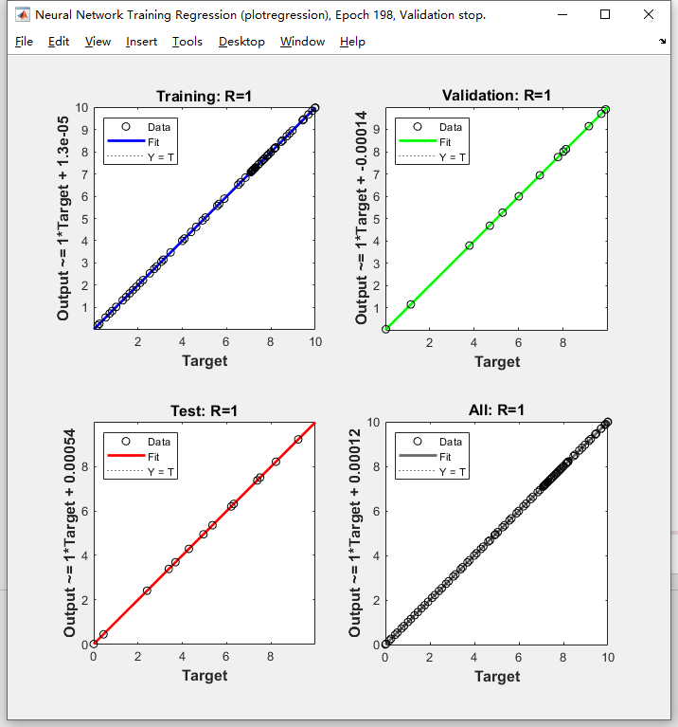
Function: feedforwardnet
Notes:
plots the linear regression of targets relative to outputs.

Slide 18
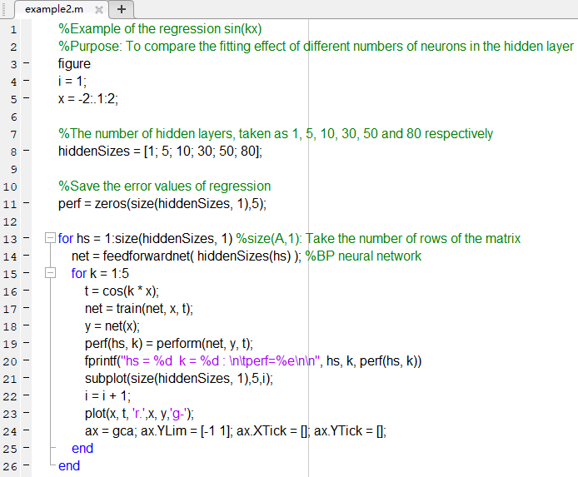
Example of the Regression sin(kx)

Slide 19
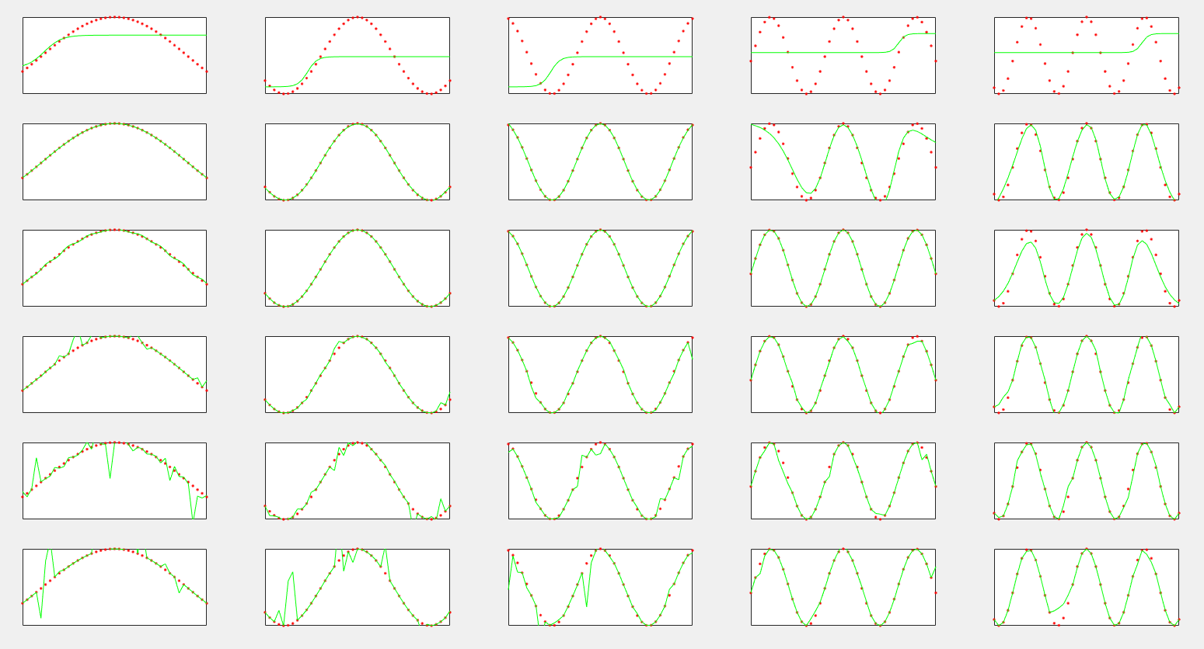
Example of the Regression sin(kx)

Slide 20
Example of the Regression sin(kx)
(i) k is certain, the larger the number of neurons in the hidden layer, the better the fitting effect, beyond a certain degree, the effect is not significant or even overfitting occurs.
(ii) When k is relatively large, the number of neurons in the hidden layer will lead to underfitting if it is too small.
(iii) When k is small, the number of neurons in the hidden layer can lead to overfitting if it is too large.
(iv) When the fitting effect is consistent, the number of required hidden layer neurons increases with the increase of k.

Slide 21
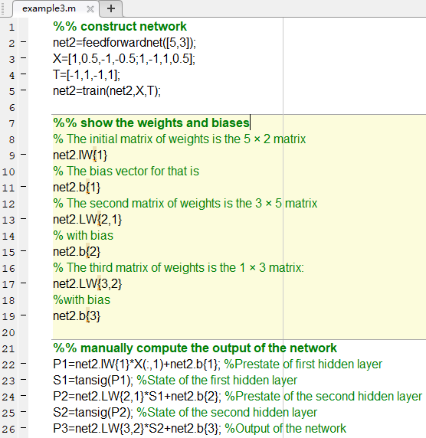
Example to Show Weights and Biases
Notes:
Here’s an example, where we build a 2 − 5 − 3 − 1 network using some data we’ve seen before in the linear net, and examine the weights and biases:
There are two sets of weights, IW and LW. The matrix associated with IW is for the initial layer (from input layer to hidden layer), and LW is going from hidden to output layer, or to the next hidden layer.
We can manually compute the output of the network:

Slide 22
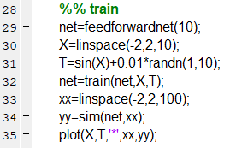
Example to Show Weights and Biases
Notes:
We can train the network (meaning we find the best weights and biases for a given data set), and we can sim or simulate the network using new data to get the network’s output.
Here’s an example, where we train the network on some simple data, then we construct some new data to put into the network and plot the results:

Slide 23
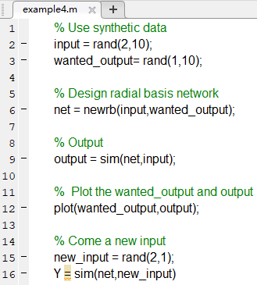
Example to use RBFN
Notes:
Here is an example of using RBF neural network

Slide 24
Thanks

